Slide 1
Afforestation save trees , save lives

Slide 2
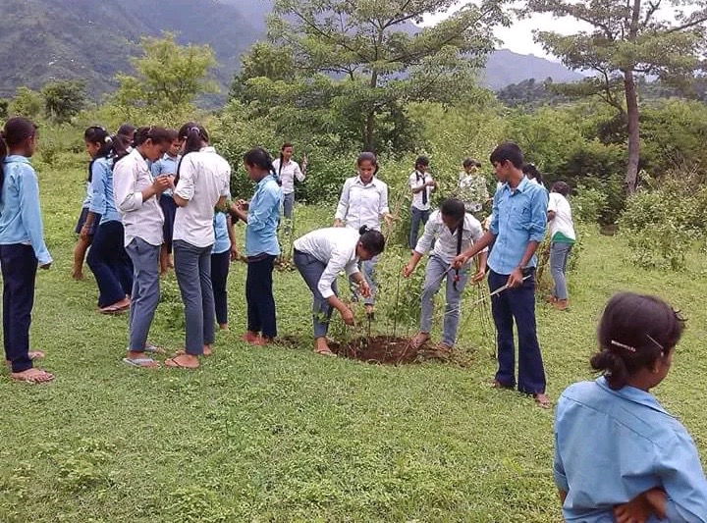

Slide 3
Deforestation don’t keep your life in risk

Slide 4
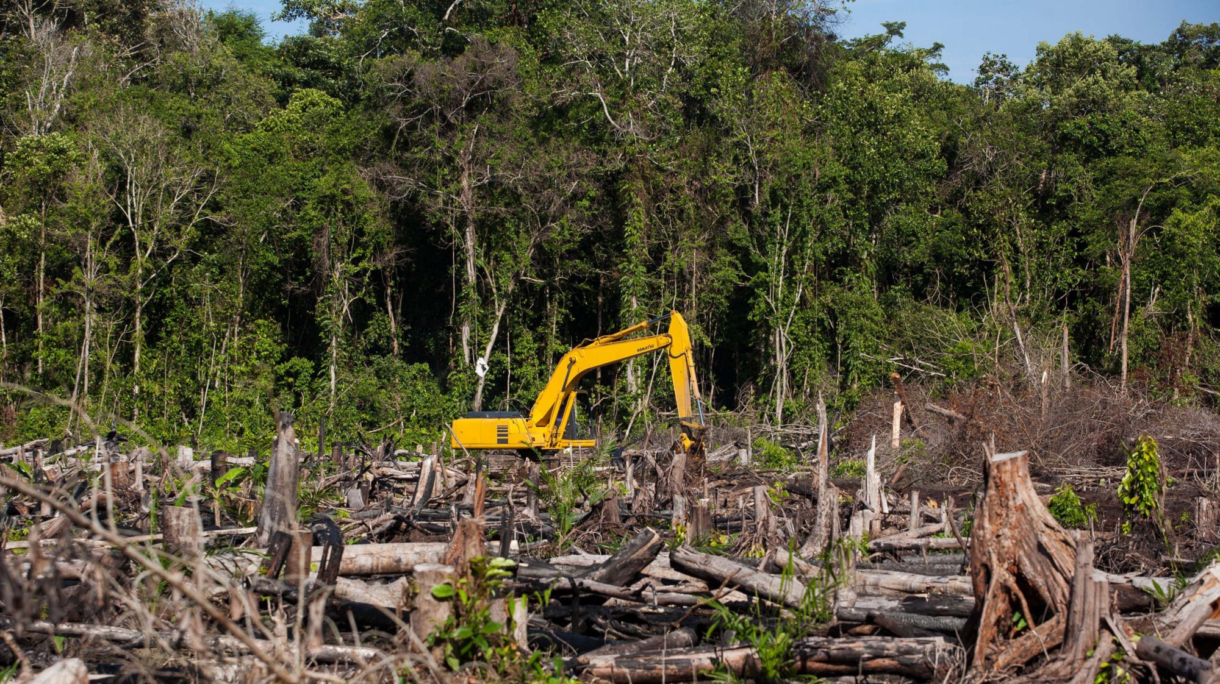

Slide 5
Done by A . Prerana

